Slide 1
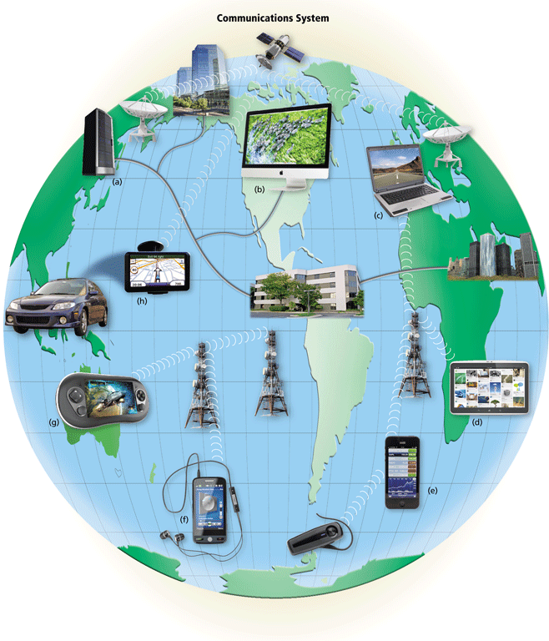
Chapter Three Data Communication and Transmission Medias
Haleluyaluya@yahoo.com

Slide 2
Transmission medium
The transmission medium is the physical path between transmitter and receiver in a data transmission system.
Transmission media are actually located below the physical layer
Based on The Path:
Guided: the waves are guided along a solid medium, such as copper twisted pair, copper coaxial cable, and optical fiber.
this form of transmission is usually referred to as wireless transmission.
UnGuided: The atmosphere and outer space are used to trnamit data;
This form of transmission is usually referred to as wireless transmission.
In considering the design of data transmission systems, a key concern, generally, is data rate and distance: the greater the data rate and distance, the better.
A number of design factors relating to the transmission medium and to the signal determine the data rate and distance:

Slide 3
Contd.
Based on the type of energy:
Electrical Energy is used on wires (Twisted Pair and Coaxial Cables),
Radio Frequency Transmission is used for wireless(Terrestrial Radio and Satellite),
Light is used for optical fibers, infrared and lasers.

Slide 4
Contd.
Some of the design factors
Bandwidth:- the greater the bandwidth of a signal, the higher the data rate that can be achieved.
Transmission impairments:- Impairments, such as attenuation, limit the distance. For guided media, twisted pair generally suffer much impairment then coaxial cable, then optical fiber.
Interference:- overlapping frequency bands. it is also a problem for unguided media, and guided media.
A Number of receivers:- A guided medium can be used to construct a point-to-point link or a shared link with multiple attachments. If multiple attachments, each attachment introduces some attenuation and distortion on the line, limiting distance and/or data rate.

Slide 5
GUIDED TRANSMSSION MEDIA
Provide a conduit from one device to another:
twisted-pair cable, coaxial cable, and fiber-optic cable.
A signal traveling along any of these media is directed and contained by the physical limits of the medium.
Twisted-pair and coaxial cable use metallic (copper) conductors that accept and transport signals in the form of electric current.
Optical fiber is a cable that accepts and transports signals in the form of light.

Slide 6
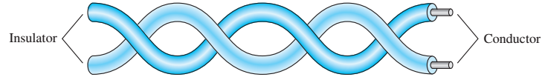
Twisted-Pair Cable (TP)
A TP consists of two conductors (normally copper), each with its own plastic insulation, twisted together
One of the wires is used to carry signals to the receiver, and the other is used only as a ground reference.
The receiver uses the difference between the two.
interference (noise) and crosstalk may affect both wires and create unwanted signals.

Slide 7
Contd.
If the two wires are parallel, the effect of these unwanted signals is not the same in both wires because they are at different locations influenced by:
Crosstalk,
electromagnetic interference (EMI),
radio frequency interference (RFI).
By twisting the pairs, a balance is maintained. b/cs both wires are equally affected
i.e when the receiver, which calculates the difference between the two, receives no unwanted signals. The unwanted signals are mostly canceled out.
The number of twists per unit of length (e.g., inch) has some effect on the quality of the cable.

Slide 8
Unshielded Versus Shielded Twisted-Pair Cable
The most common twisted-pair cable used in communications is referred to as unshielded twisted-pair (UTP).
IBM has also produced a version of twisted-pair cable for its use called shielded twisted-pair (STP).
STP cable has a metal foil or braided mesh covering that encases each pair of insulated conductors.
Metal casing improves the quality of cable by preventing the penetration of noise or crosstalk, But bulkier and more expensive.
STP is seldom used outside of IBM.

Slide 9
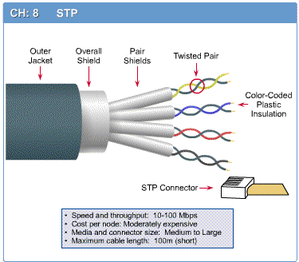
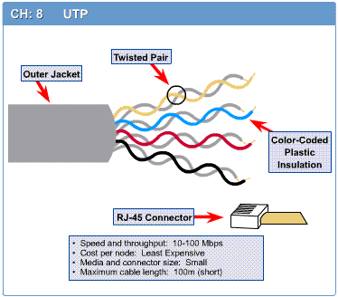
STP
UTP
Notes:
STP

Slide 10
UTP Categories
The Electronic Industries Association (EIA) has developed standards to classify unshielded twisted-pair cable into seven categories.
Categories are determined by cable quality, with 1 as the lowest and 7 as the highest.
Each EIA category is suitable for specific uses.

Slide 11
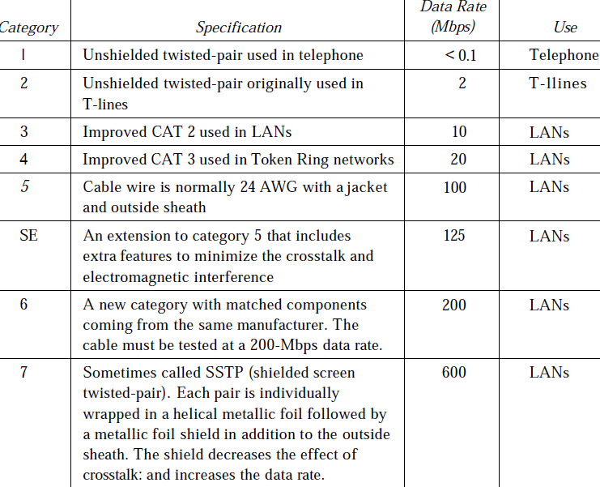


Slide 12
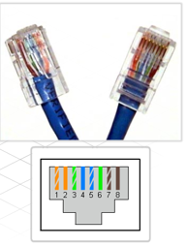
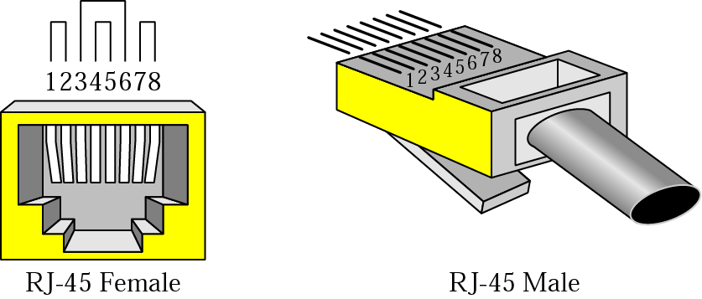
Connectors
The most common UTP connector is RJ45 (RJ stands for registered jack). The RJ45 is a keyed connector, meaning the connector can be inserted in only one way.

Slide 13
Twisted-pair cable Applications
Within buildings
Most common medium
Twisted-pair cables are used in telephones lines to provide voice and data channels.
The DSL lines that are used by the telephone companies to provide high data rate connections also use the high-bandwidth capability of unshielded twisted-pair cables.
Local area networks, such as 10Base-T and 100Base-T, also used UTP cables.

Slide 14
Advantages
Simple
Low weight
Easily connectable
Inexpensive
Physically flexible
Easy install & maintain

Slide 15
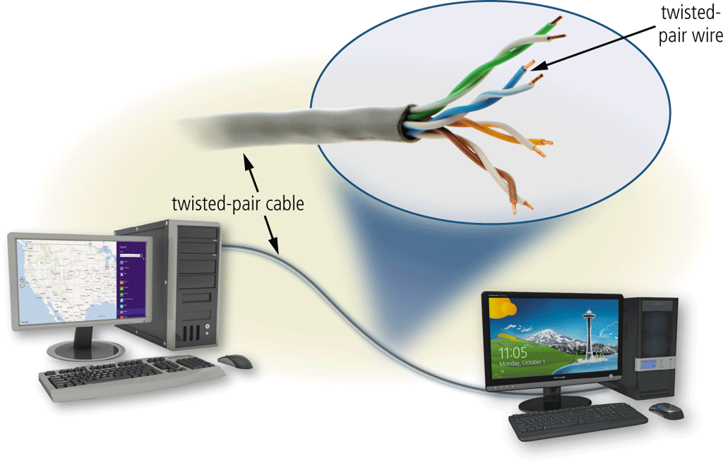
Disadvantages
Incapable of carrying signal over long distances due to high attenuation.
Low bandwidth capabilities-unsuitable for broadband applications.
max. data rates = 1 Mbps- without conditioning
10 Mbps with conditioning

Slide 16
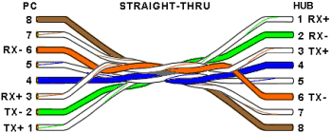
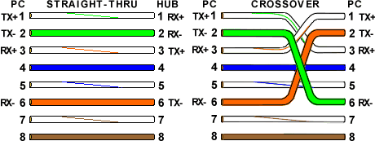


UTP connections
Pin of the source device vs pin of the destination device. There are three types of connections:
Straight through cables
Crossover Cables
Rollover cables
Straight through cables
They are used to connect dissimilar devices.
Switch/Hub to PC
Switch/Hub to Router
Cross over cable
The crossover cable can be used to connect similar devices
Hub to hub
Switch to switch
Hub to switch
PC to PC
PC to Router
Console (Rolled) Cable
Although rolled cable isn’t used to connect any Ethernet connections together, you can use a rolled Ethernet cable to connect a PC to a router console serial communication (com) port (used to connect a PC with console port of a router). If you have a Cisco router or switch, you would use this cable to connect your PC running HyperTerminal to the Cisco hardware.

Slide 17
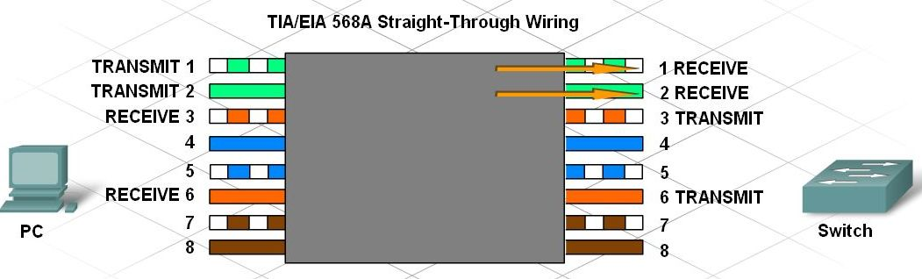
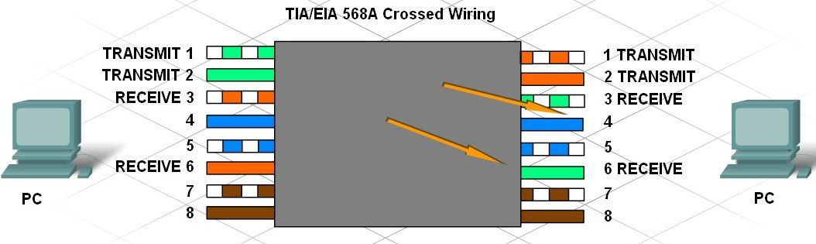
Construct and Terminate Twisted Pair Cables
Identify and describe the cross-over and straight through cable pinouts and color codes

Slide 18
Unshielded Twisted Pair | Shielded Twisted Pair
UTP Advantages: Least expensive Easy to install High speed capacity UTP Disadvantages: Susceptible to external interference Lower capacity and performance in comparison to STP Short distance transmission due to attenuation | STP Advantages: Better performance at a higher data rate in comparison to UTP Eliminates crosstalk Comparitively faster STP Disadvantages: Comparitively difficult to install and manufacture More expensive Bulky

Slide 19
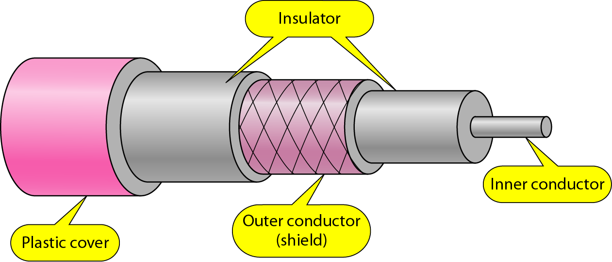
Coaxial Cable
Coaxial cable (or coax) carries signals of higher frequency ranges than twisted pair cable.
Has a central core conductor of solid or stranded wire (usually copper) enclosed in an insulating sheath, which is, in turn, encased in an outer conductor of metal foil, braid, or a combination of the two.
The outer metallic wrapping serves both as a shield against noise and as the second conductor, which completes the circuit.
This outer conductor is also enclosed in an insulating sheath, and the whole cable is protected by a plastic cover

Slide 20
Contd.
coaxial cable was the most widely used network cabling.
Reasons for coaxial cable's wide usage: it was relatively inexpensive, and it was light, flexible, and easy to work with.
The term shielding refers to the woven or stranded metal mesh (or other material) that surrounds some types of cabling.
Shielding protects transmitted data by absorbing stray electronic signals, called noise, so that they do not get onto the cable and distort the data.
Cable that contains one layer of foil insulation and one layer of braided metal shielding is referred to as dual shielded.
For environments that are subject to higher interference, quad shielding is available.
Quad shielding consists of two layers of foil insulation and two layers of braided metal shielding.

Slide 21
Types of Coaxial Cable
Thin (thinnet) cable
Thick (thicknet) cable
Thinnet(10Base2):- is a flexible coaxial cable about 0.64 centimeters (0.25 inches) thick.
Because this type of coaxial cable is flexible and easy to work with, it can be used in almost any type of network installation.
Thicknet(10Base5):- is a relatively rigid coaxial cable about 1.27 centimeters (0.5 inches) in diameter.
Thicknet cable is sometimes referred to as Standard Ethernet because it was the first type of cable used with the popular network architecture Ethernet.
Thicknet cable's copper core is thicker than a thinnet cable core.
The thicker the copper core, the farther the cable can carry signals.
Thicknet cable can carry a signal for 500 meters (about 1640 feet).
it is sometimes used as a backbone to connect several smaller thinnet-based networks

Slide 22
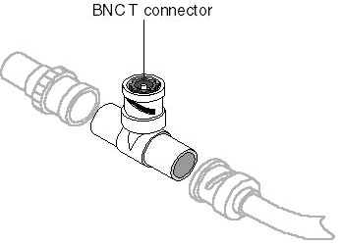
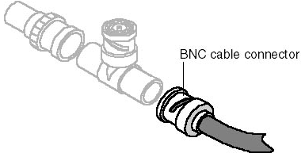
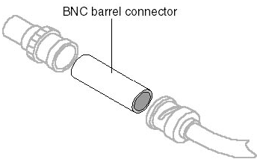
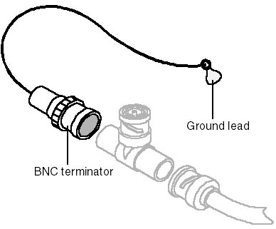
Connector

Slide 23
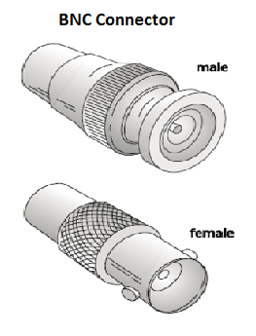
Contd.
The BNC connector is used to connect the end of the cable to a device, such as a TV set.
The BNC T connector is used in Ethernet networks to branch out to a connection to a computer or other device.
The BNC terminator is used at the end of the cable to prevent the reflection of the signal
BNC barrel connector is used to join two lengths of thinnet cable to make one longer length.

Slide 24
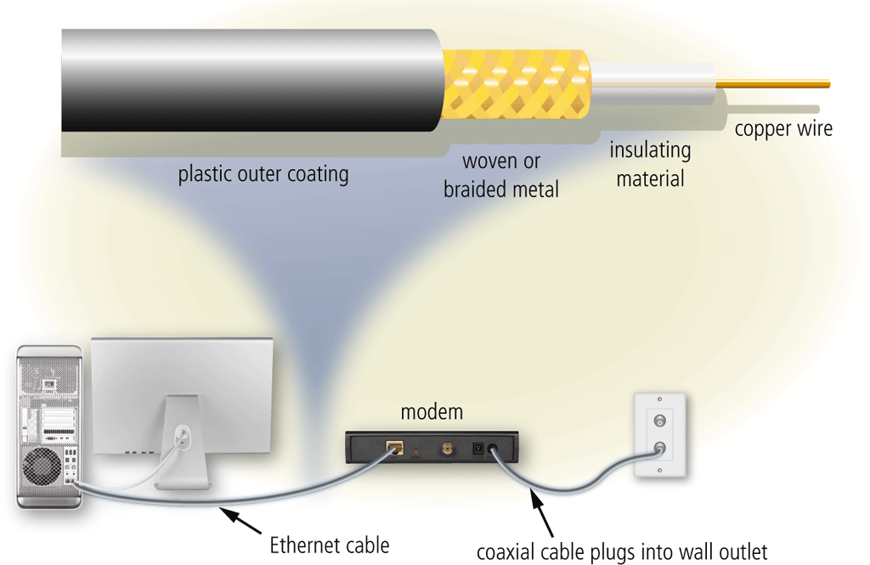
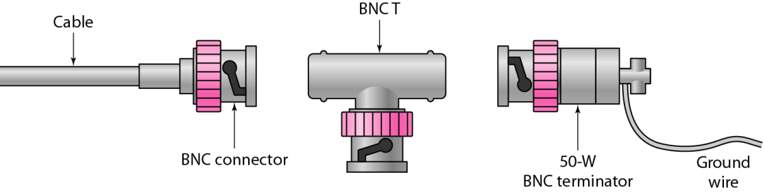
Coaxial Cable Applications
Most versatile medium
Television distribution
Ariel to TV
Cable TV
Long distance telephone transmission
Can carry 10,000 voice calls simultaneously
Being replaced by fiber optic
Short distance computer systems links
Local area networks

Slide 25
Fiber-Optic Cable
A fiber-optic cable is made of glass or plastic and transmits signals in the form of light.
Fiber-optic cabling consists of a signal-carrying glass core of 5 to 100 microns in diameter (a sheet of paper is about 25 microns thick and a human hair about 75 microns thick), surrounded by a layer of pure silica called cladding, which prevents light from escaping.
Surrounding the cladding are protective layers of acrylic plastic coating, Kevlar fibers for additional strength, and a PVC (polyvinyl chloride) jacket (usually colored a distinctive orange).

Slide 26

Contd.
Network components use LED or laser diodes to convert electrical signals into light pulses for transmission on fiber-optic cables.
An optical detector is used to convert the light pulses back into electrical signals.
Optical fibers use reflection to guide light through a channel.
A glass or plastic core is surrounded by a cladding of less dense glass or plastic.

Slide 27
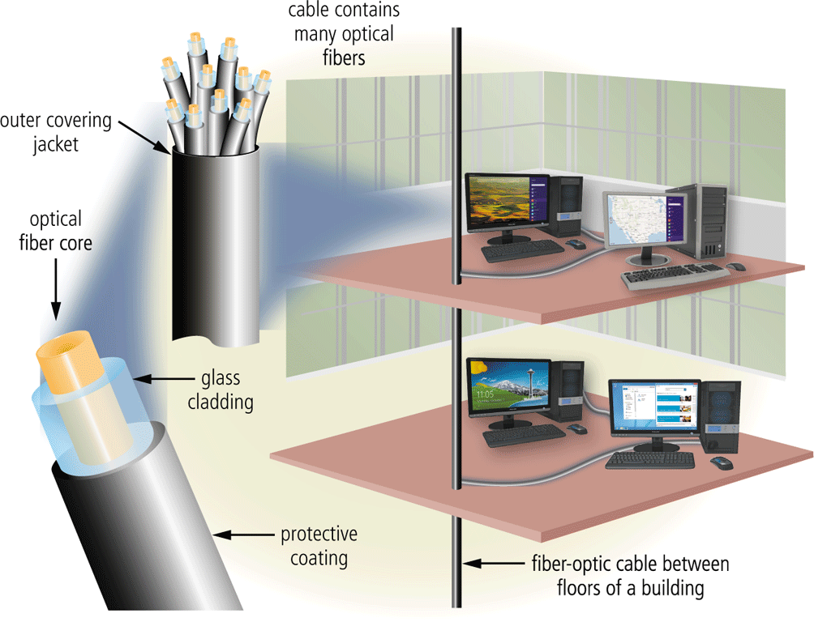
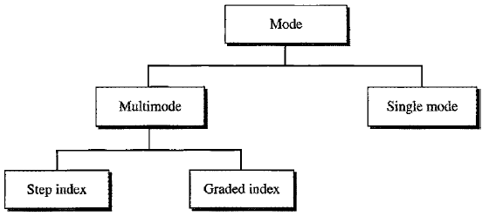
Propagation Modes
Current technology supports two modes (multimode and single mode) for propagating light along optical channels.
Multimode can be implemented in two forms: step-index or graded-index

Slide 28
Single-mode fiber-optic cabling
Has a narrow core (5 or 10 microns in diameter) and allows only one signal to be sent or received at a time over very long distances [about 50 kms](up to 50 times farther than multimode fiber-optic cabling).
Single-mode fiber-optic cabling uses laser-emitting diodes to introduce signals into the fiber and can transmit only one signal (light beam) at a time.
Signal transmission is clear for approximately 30 miles (50 kilometers) before dispersion will distort signals, which means that single-mode fiber is ideal for long cable runs.
Is suitable for long-distance telephony and multichannel television broadcast systems

Slide 29
Multimode fiber-optic cabling:
Has a thicker core (50, 62.5, or 100 microns in diameter) and has sufficient bandwidth to allow multiple signals to be simultaneously transmitted or received;
Each signal follows a different path or mode through the fiber.
Signal transmission is clear for approximately 3000 feet (almost 1km), but longer cable runs can distort signals through modal dispersion.
There are two types of multimode fiber:
Step-index multimode fiber
Graded-index multimode fiber
is suited for use in LAN systems and video surveillance.

Slide 30
Step-index multimode fiber
Less costly variety of multimode fiber, uses a wide core with a constant density from the center to the edges, causing the light beams to reflect in mirror fashion off the inside surface of the core by the process of total internal reflection
At the interface there is an abrupt change to a lower density that alters the angle of the beam’s motion.
Because light can take many different paths down the cable and each path takes a different amount of time, signal distortion can result when step-index fiber is used for long cable runs.
Used only for short cable runs.

Slide 31
Graded-index multimode fiber
The more expensive type of multimode fiber.
A graded-index fiber is one with varying densities.
Density is highest at the center of the core and decreases gradually to its lowest at the edge.
Therefore, light beams follow curved paths and all rays reach the end of the fiber simultaneously
This reduces the signal distortion that occurs in step-index fiber when long cable runs are used.

Slide 32
Types of Optical Fiber
Multimode stepped index
Cladding and core each have a different but uniform refractive index
Signal has a wider pulse width => modest bit rates
Multimode graded index
Core material has a variable refractive index
Light is refracted by an increasing amount as it moves away from the core => narrows pulse width
Monomode
Reduces core diameter to that of a single wavelength (3-10 micrometers)
Light propagates along a single path => width of output signal = width of input signal

Slide 33
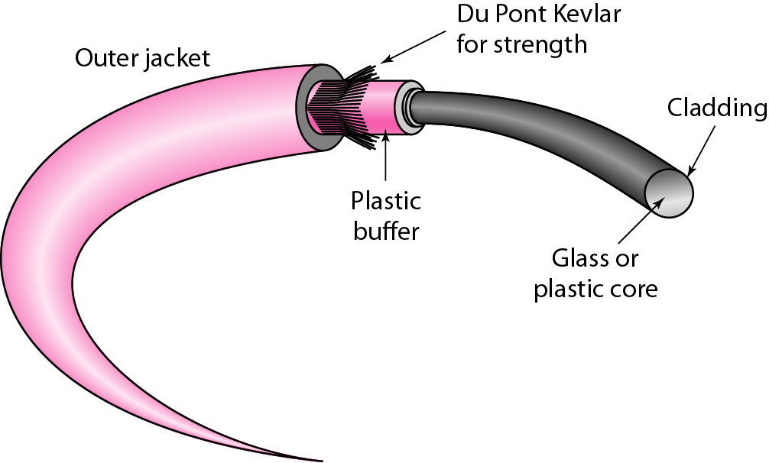
Cable Composition
The outer jacket is made of either PVC (polymer of vinyl chloride) or Teflon.
Inside the jacket are Kevlar strands to strengthen the cable.
Kevlar is a strong material used in the fabrication of bulletproof vests.
Below the Kevlar is another plastic coating to cushion the fiber.
The fiber is at the center of the cable, and it consists of cladding and core.

Slide 34
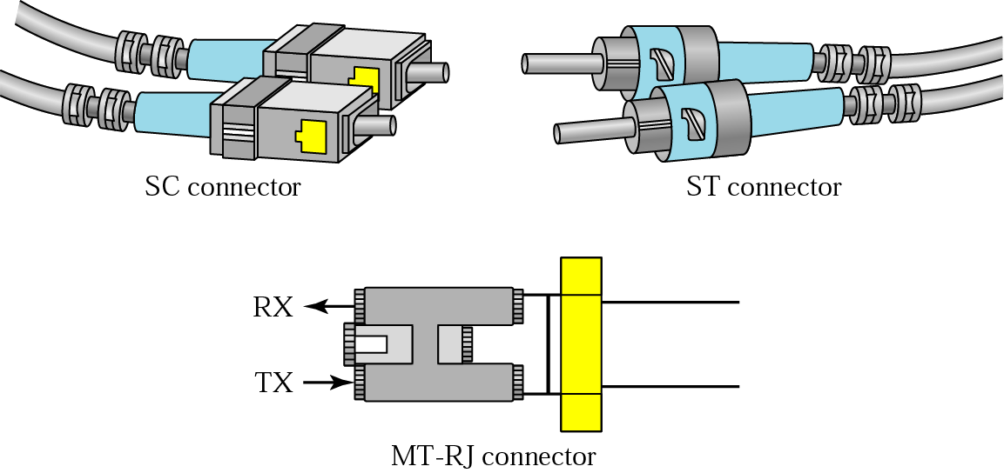
Fiber-Optic Cable Connectors
There are three types of connectors for fiber-optic cables.
Subscriber channel (SC) connector:- is used for cable TV. It uses a push/pull locking system.
Straight-tip (ST) connector:- is used for connecting cable to networking devices. It uses a bayonet locking system and is more reliable than SC.
MT-RJ is a connector:- that is the same size as RJ45.

Slide 35
Optical Fiber - Applications
Long-haul trunks
Metropolitan trunks
Rural exchange trunks
Subscriber loops
LANs

Slide 36
Advantages of Optical Fiber
The major advantages offered by fiber-optic cable over twisted-pair and coaxial cable are noise resistance, less signal attenuation, and higher bandwidth.
Noise Resistance: Because fiber-optic transmission uses light rather than electricity, noise is not a factor. External light, the only possible interference, is blocked from the channel by the outer jacket.
Less signal attenuation:- Fiber-optic transmission distance is significantly greater than that of other guided media. A signal can run for miles without requiring regeneration.
Higher bandwidth:- Currently, data rates and bandwidth utilization over fiber-optic cable are limited not by the medium but by the signal generation and reception technology available.

Slide 37
Disadvantages of Optical Fiber
The main disadvantages of fiber optics are cost, installation/maintenance, and fragility.
Cost:- Fiber-optic cable is expensive. Also, a laser light source can cost thousands of dollars, compared to hundreds of dollars for electrical signal generators.
Installation/maintenance
Fragility:- Glass fiber is more easily broken than wire, making it less useful for applications where hardware portability is required.

Slide 38
Cautions about Optical Fiber
Warning: The laser light used with single-mode has a longer wavelength than can be seen. The laser is so strong that it can seriously damage eyes.
Never look at the near end of a fiber that is connected to a device at the far end.
Never look into the transmit port on a NIC, switch, or router. Remember to keep protective covers over the ends of fiber and inserted into the fiber-optic ports of switches and routers. Be very careful.

Slide 39
Optical Fiber - Transmission Characteristics
Act as wave guide for 10¹⁴ to 10¹⁵ Hz
Portions of infrared and visible spectrum
Light Emitting Diode (LED)
Cheaper
Wider operating temp range
Last longer
Injection Laser Diode (ILD)
More efficient
Greater data rate
Wavelength Division Multiplexing

Slide 40
Comparison Table
Type | Type Sub type | Max.Segment Length | Bandwidth supported | installation | cost | Interference
Twisted pair cable | UTP STP | 100 mts 100 mts | 100 Mbps 500 Mbps | Easy moderate | Cheapest moderate | High moderate
Coaxial cable | Thinnet Thicknet | 185 mts 500 mts | 10 Mbps 10 Mbps | Easy hard | Cheap moderate | Moderate Low
Fiber optic cable | Multimode Singlemode | 2 kms 100 kms | 100 Mbps 2 Gbps | Very hard Very hard | Expensive Expensive | None None

Slide 41
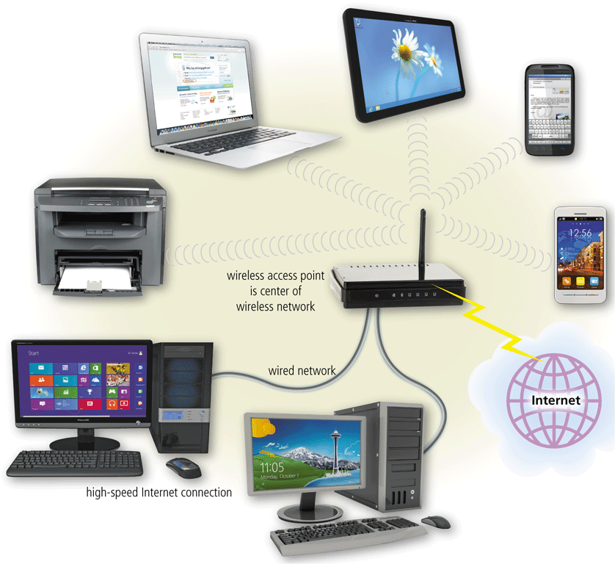
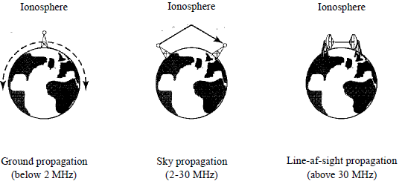
Unguided (Wireless) Media
Unguided media transport electromagnetic waves without using any physical conductor.
This type of communication is often referred to as wireless communication.
Signals are normally broadcast through free space and thus are available to anyone who has a device capable of receiving them.
Unguided signals can travel from the source to destination in several ways: ground propagation, sky propagation, and line-of-sight propagation.

Slide 42
Contd.
In ground propagation, radio waves travel through the lowest portion of the atmosphere, hugging the earth.
These low-frequency signals emanate in all directions from the transmitting antenna and follow the curvature of the planet.
Distance depends on the amount of power in the signal: The greater the power, the greater the distance.
In sky propagation, higher-frequency radio waves radiate upward into the ionosphere (the layer of atmosphere where particles exist as ions) where they are reflected back to earth.
This type of transmission allows for greater distances with lower output power.

Slide 43
Contd.
In line-of-sight propagation, very high-frequency signals are transmitted in straight lines directly from antenna to antenna.
Antennas must be directional, facing each other, and either tall enough or close enough together not to be affected by the curvature of the earth.
Line-of-sight propagation is tricky because radio transmissions cannot be completely focused.
These bands are rated from very low frequency (VLF) to extremely high frequency (EHF).

Slide 44
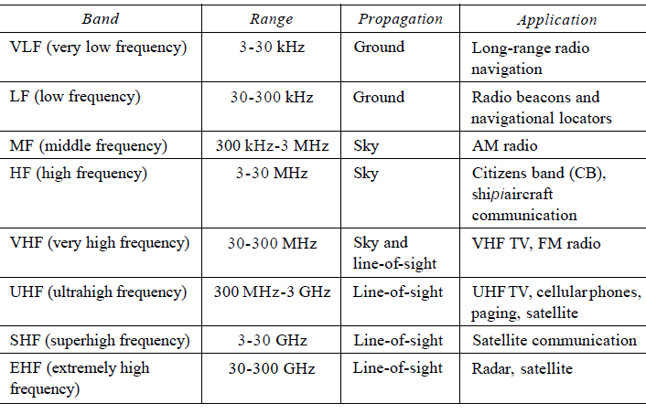
Contd.

Slide 45
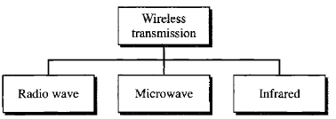
Wireless Transmission Types
We can divide wireless transmission into three broad groups: radio waves, microwaves, and infrared waves.

Slide 46
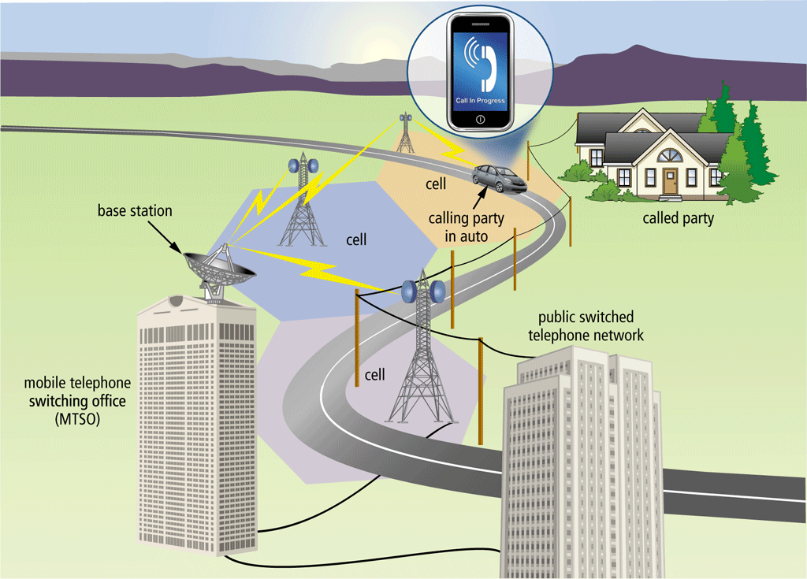
Radio Waves
No clear-cut demarcation between radio waves and microwaves,
electromagnetic waves 3 kHz and 1 GHz are normally called radio waves; 1 and 300 GHz are called microwaves.
Bbehavior: Radio waves, for the most part, are Omni-directional, antenna propagated in all directions.
This means that the sending and receiving antennas do not have to be aligned. A sending antenna sends waves that can be received by any receiving antenna.

Slide 47
Contd.
Radio waves, that propagate in the sky mode, can travel long distances. This makes radio waves a good candidate for long-distance broadcasting such as AM radio.
Radio waves, particularly those of low and medium frequencies, can penetrate walls.
This characteristic can be both an advantage and a disadvantage.
It is an advantage because, for example, an AM radio can receive signals inside a building.
It is a disadvantage because we cannot isolate a communication to just inside or outside a building.

Slide 48
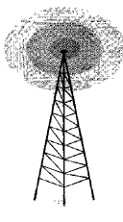
Contd.
Applications
The unidirectional characteristics of radio waves make them useful for multicasting, in which there is one sender but many receivers.
AM and FM radio, television, maritime radio, cordless phones, etc are examples of multicasting.

Slide 49
Microwaves
Electromagnetic waves having frequencies between 1 and 300 GHz are called microwaves.
Microwaves are unidirectional. When an antenna transmits microwave waves, they can be narrowly focused. The unidirectional property has an obvious advantage. A pair of antennas can be aligned without interfering with another pair of aligned antennas.
some characteristics of microwave propagation:
Microwave propagation is line-of-sight. So need to be very tall.

Slide 50
Contd.
The curvature of the earth as well as other blocking obstacles do not allow to communicate by using microwaves.
Repeaters are often needed for long distance communication.
Very high-frequency microwaves cannot penetrate walls.
Is a disadvantage, if receivers are inside buildings.
The microwave band is relatively wide, almost 299 GHz.
wider subbands can be assigned, and a high data rate is possible

Slide 51
Unidirectional Antenna
Microwaves need unidirectional antennas that send out signals in one direction.
Two types of antennas: the parabolic dish and the horn.
A parabolic dish antenna :
Every line parallel to the line of sight reflects off the curve at angles such that all the lines intersect in a common point called the focus.
The parabolic dish works as a funnel, catching a wide range of waves and directing them to a common point.
More of the signal is recovered than would be possible with a single-point receiver.
The microwaves hit the dish and are deflected outward in a reversal of the receipt path.

Slide 52
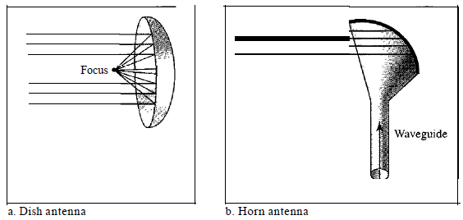
Contd.
A horn antenna looks like a gigantic scoop.
Outgoing transmissions are broadcast up a stem (resembling a handle) and deflected outward in a series of narrow parallel beams by the curved head.
Received transmissions are collected by the scooped shape of the horn, in a manner similar to the parabolic dish, and are deflected down into the stem.

Slide 53
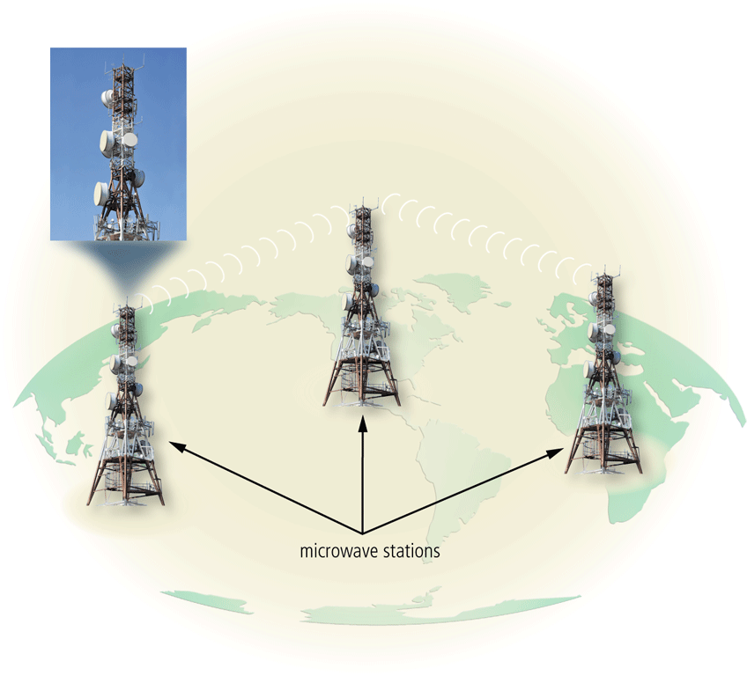
Applications
Microwaves, due to their unidirectional properties, are very useful when unicast (one-to-one) communication is needed between the sender and the receiver.
They are used in cellular phones, satellite networks , and wireless LANs.

Slide 54
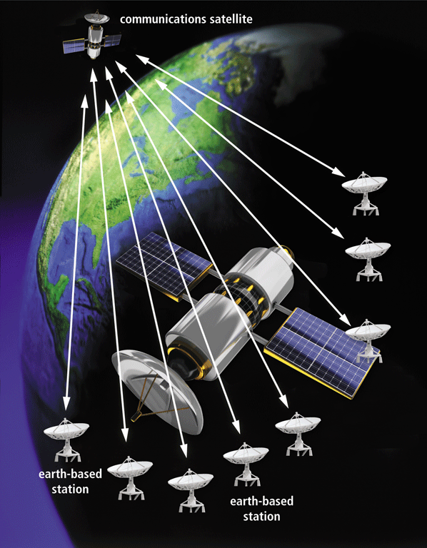
Satellite
A communications satellite is a space station that receives microwave signals from an earth-based station, amplifies it, and broadcasts the signal over a wide area

Slide 55
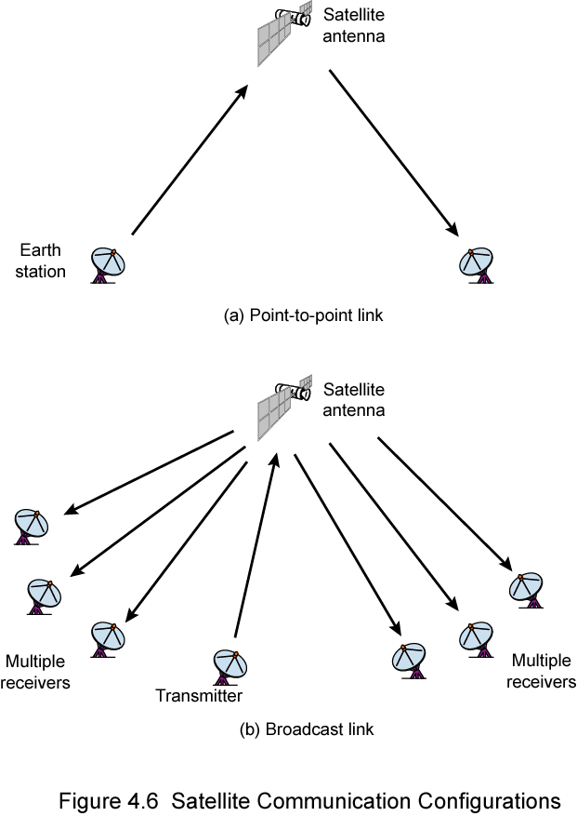
Satellite Point to Point Link
Satellite Broadcast Link

Slide 56
Infrared
Frequencies from 300 GHz to 400 THz (wavelengths from 1 mm to 770 nm), can be used for short-range communication.
cannot penetrate walls.
This advantageous characteristic prevents interference between one system and another; a short-range communication system in one room cannot be affected by another system in the next room.
However, useless for long-range communication.
We cannot use infrared waves outside a building because the sun's rays contain infrared waves that can interfere with the communication.

Slide 57
Applications
The infrared band, almost 400 THz, has an excellent potential for data transmission.
Such a wide bandwidth can be used to transmit digital data with a very high data rate.
The Infrared Data Association (IrDA), an association for sponsoring the use of infrared waves, has established standards for using these signals for communication between devices such as keyboards, mice, PCs, and printers.
The standard originally defined a data rate of 75 kbps for a distance up to 8 m. The recent standard defines a data rate of 4 Mbps.
Infrared signals defined by IrDA transmit through line of sight; the IrDA port on the keyboard needs to point to the PC for transmission to occur.

Slide 58
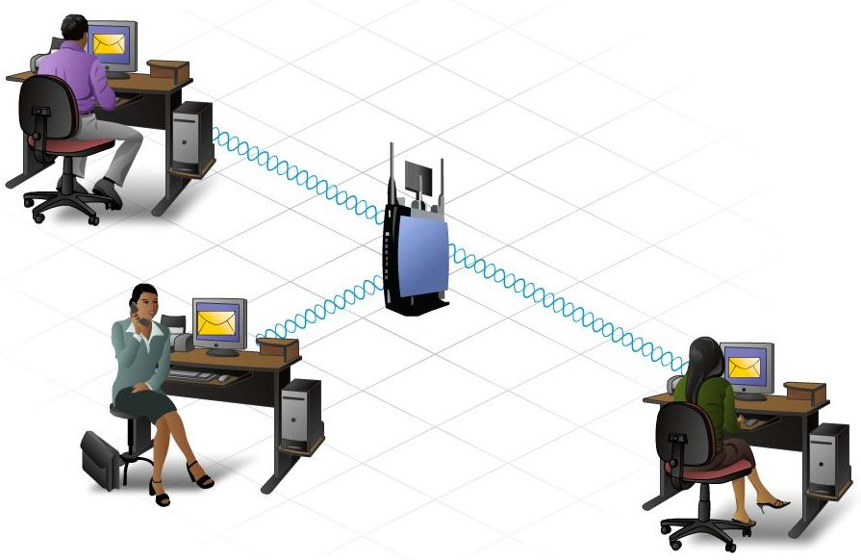
Wireless Technologies
Pros
Anytime, anywhere connectivity with hotspots
Easy and cheap installation
Device prices dropping
Data rate capabilities increasing
Easy expansion
Cons
Unlicensed RF which is crowded with other devices
Bluetooth
Microwaves
Cordless phones
Security is difficult
Encryption helps, but can be defeated
Fluctuations in temperature and humidity can really affect transmission range.
Notes:
Wireless technology offers many advantages compared to traditional wired networks.
One of the main advantages is the ability to provide anytime, anywhere connectivity. The widespread implementation of wireless in public locations, known as hotspots, allows people to easily connect to the Internet to download information and exchange emails and files.
Wireless technology is fairly easy and inexpensive to install. The cost of home and business wireless devices continues to decrease. Yet, despite the decrease in cost, the data rate and capabilities of these devices have increased, allowing faster, more reliable wireless connections.
Wireless technology enables networks to be easily expanded, without the limitations of cabled connections. New and visiting users can join the network quickly and easily.
Despite the flexibility and benefits of wireless, there are some limitations and risks.
First, Wireless LAN (WLAN) technologies make use of the unlicensed regions of the RF spectrum. Since these regions are unregulated, many different devices make use of them. As a result, these regions are congested and signals from different devices often interfere with each other. In addition, many devices such as microwave ovens and cordless phones use these frequencies and can interfere with WLAN communications.
Second, a major concern with wireless is security. Wireless provides ease of access. It does this by broadcasting data in a manner that allows anyone the ability to access it. However, this same feature also limits the amount of protection wireless can provide for the data. It allows anyone to intercept the communication stream, even unintended recipients. To address these security concerns, techniques have been developed to help secure wireless transmissions including encryption and authentication.

Slide 59
?

